Slide 1
The Greedy Methods
Algorithms & Data Structures
ITCS 6114/8114
Dr. Dewan Tanvir Ahmed
Department of Computer Science
University of North Carolina at Charlotte

Slide 2
The Greedy Method

Slide 3
Outline and Reading
The Greedy Method Technique (§5.1)
Fractional Knapsack Problem (§5.1.1)
Task Scheduling (§5.1.2)
Minimum Spanning Trees (§7.3) [future lecture]
Huffman Coding (Cormen)

Slide 4
The Greedy Method Technique
The greedy method is a general algorithm design paradigm, built on the following elements:
configurations: Searching through a set of configurations to find one that optimizes objective function
objective function: a score assigned to configurations, which we want to either maximize or minimize
It works best when applied to problems with the greedy-choice property:
a globally-optimal solution can always be found by a series of local improvements from a starting configuration.

Slide 5
Greedy Algorithms - Examples
Fractional Knapsack algorithm
Huffman codes
MST algorithm (Kruskal's )
MST algorithm (Prim's )
Single Source Shortest Path algorithm (Dijkstra's )

Slide 6
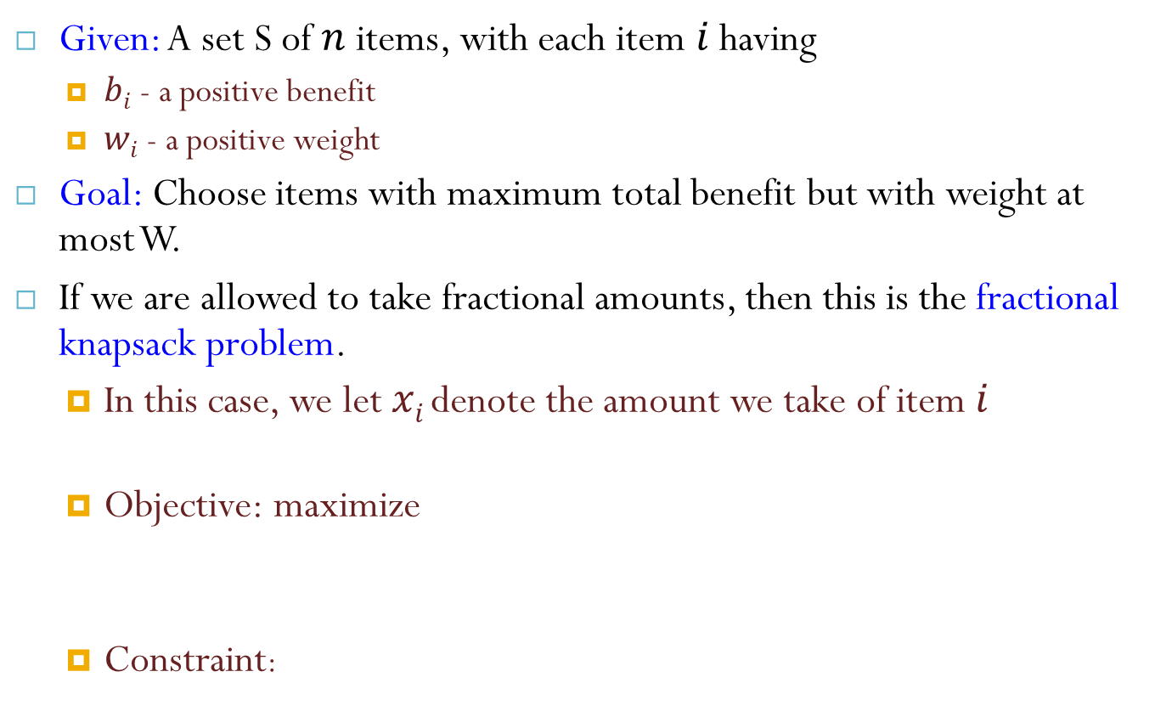
The Fractional Knapsack Problem
Given: A set S of $n$ items, with each item $i$ having
$bi$ - a positive benefit
$wi$ - a positive weight
Goal: Choose items with maximum total benefit but with weight at most W.
If we are allowed to take fractional amounts, then this is the fractional knapsack problem.
In this case, we let $xi$denote the amount we take of item$i$
Objective: maximize
Constraint:

Slide 7
Example
“knapsack”
Solution:
1 ml of 5
2 ml of 3
6 ml of 4
1 ml of 2
Items:
1
2
3
4
5
Weight:
4 ml
8 ml
2 ml
6 ml
1 ml
Benefit:
$12
$32
$40
$30
$50
10 ml
Value:
3
4
20
5
50
($ per ml)

Slide 8

The Fractional Knapsack Algorithm
Sort items in decreasing order of value per weight (lb)
While room in the knapsack (limit of $W lb$) do
consider next item in the sorted list
take as much as possible (all there is or as much as will fit)

Slide 9
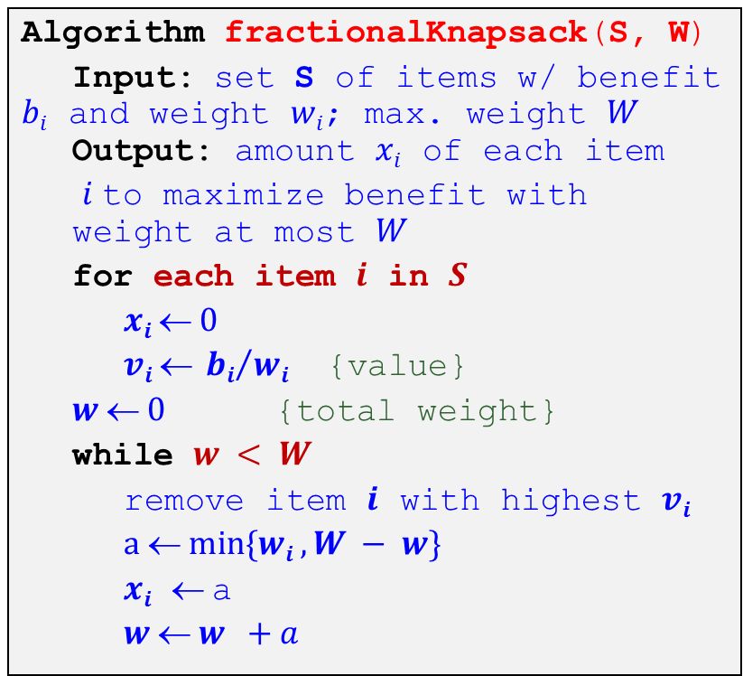

The Fractional Knapsack Algorithm
Greedy choice:
Keep taking item with highest value (benefit to weight ratio)
Since
Run time:
Algorithm fractionalKnapsack(S, W)
Input: set S of items w/ benefit $bi$ and weight $wi$; max. weight $W$ Output: amount $xi$ of each item
$i$to maximize benefit with weight at most $W$
for each item $i$ in $S$
$xi  0$
$vi  {bi}/{wi}$ {value}
$w  0$ {total weight}
while $w < W$
remove item $i$ with highest $vi$
$a  min⁡\{wi , W − w\}$
$xi$ $$a
$w  w +a$
$O(n log⁡n)$. Why?
Sorting time or
Heap based priority queue to store the items of S, where the key of each items is its value index

Slide 10
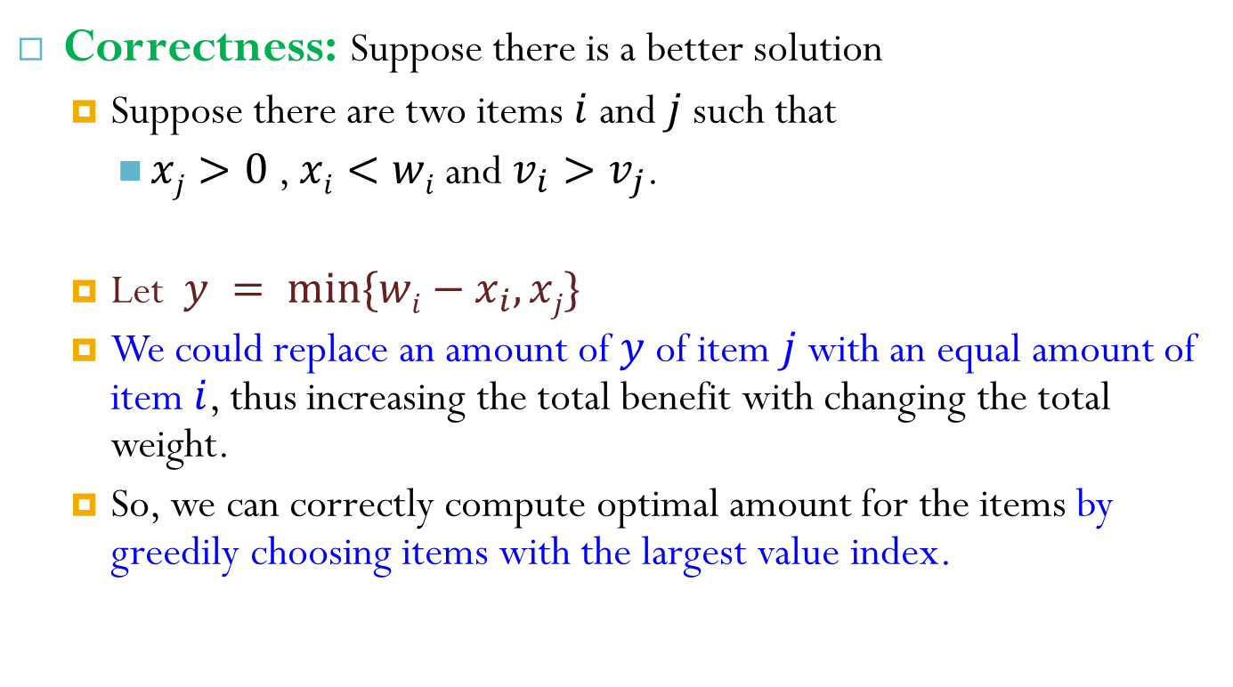
The Fractional Knapsack Algorithm
Correctness: Suppose there is a better solution
Suppose there are two items $i$ and $j$ such that
$xj>0$ , $xi<wi$ and $v_{i}>v_{j}$.
Let $y = min⁡\{wi−x_{i}, xj\}$
We could replace an amount of $y$of item $j$ with an equal amount of item $i$, thus increasing the total benefit with changing the total weight.
So, we can correctly compute optimal amount for the items by greedily choosing items with the largest value index.

Slide 11
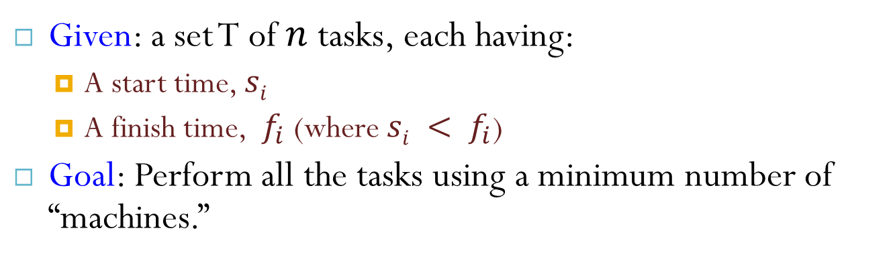
Task Scheduling
Given: a set T of $n$ tasks, each having:
A start time, $si$
A finish time, $f_{i}$ (where $si < f_{i}$)
Goal: Perform all the tasks using a minimum number of “machines.”
Machine 3
Machine 2
Machine 1
1
2
3
4
5
6
7
8
9

Slide 12
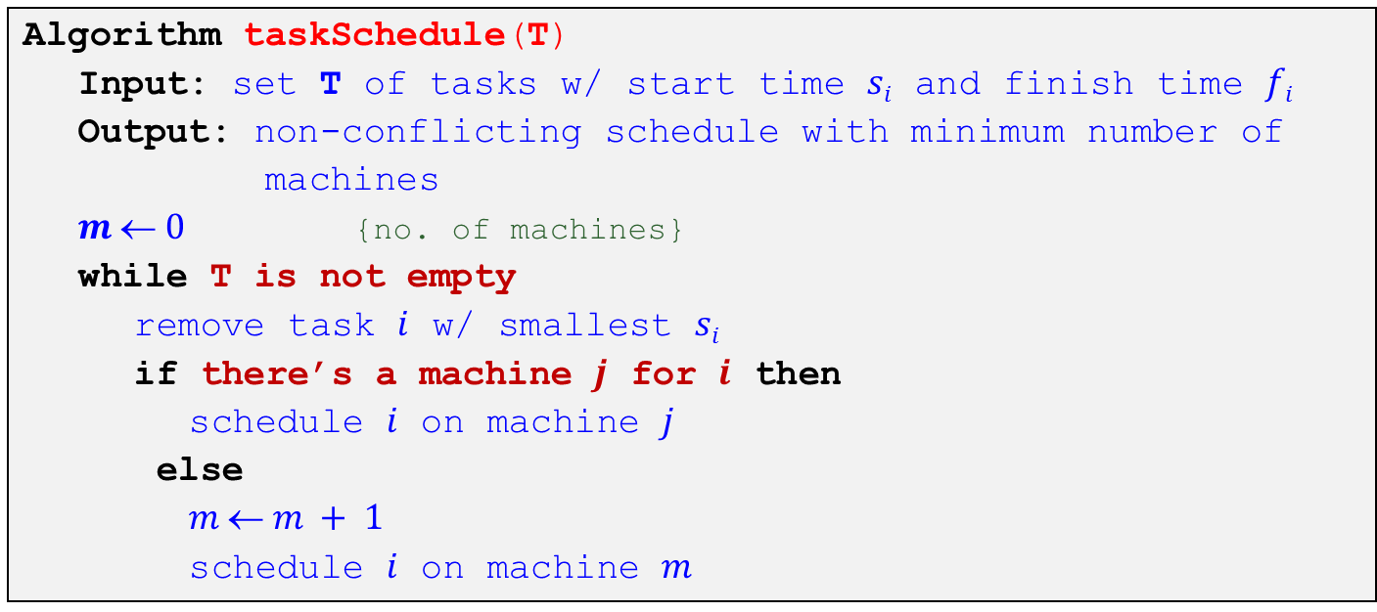
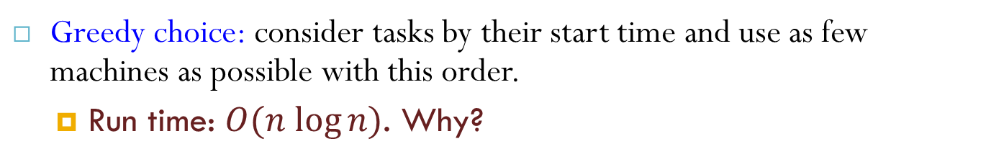
Task Scheduling Algorithm
Greedy choice: consider tasks by their start time and use as few machines as possible with this order.
Run time: $O(n log⁡n)$. Why?
Algorithm taskSchedule(T)
Input: set T of tasks w/ start time $si$ and finish time $fi$
Output: non-conflicting schedule with minimum number of
machines
$m  0$ {no. of machines}
while T is not empty
remove task $i$ w/ smallest $si$
if there’s a machine $j$ for $i$ then
schedule $i$ on machine $j$
else
$m  m + 1$
schedule $i$ on machine $m$

Slide 13
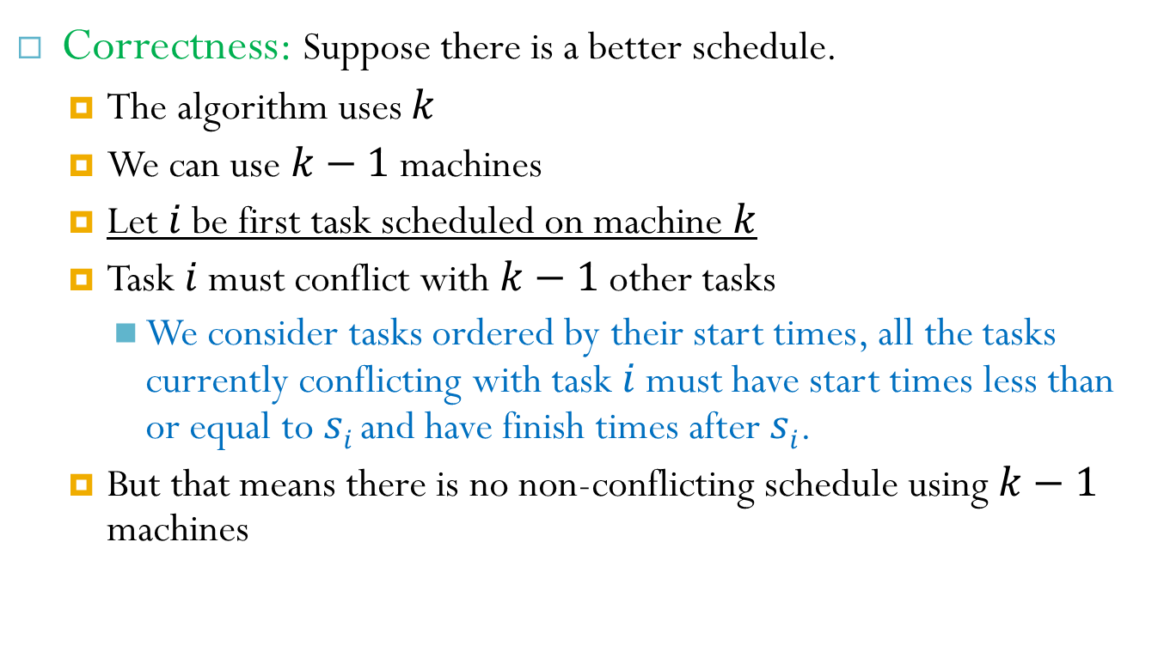
Task Scheduling Algorithm
Correctness: Suppose there is a better schedule.
The algorithm uses $k$
We can use $k−1$ machines
Let $i$ be first task scheduled on machine $k$
Task $i$ must conflict with $k−1$ other tasks
We consider tasks ordered by their start times, all the tasks currently conflicting with task $i$ must have start times less than or equal to $si$and have finish times after $si$.
But that means there is no non-conflicting schedule using $k−1$ machines

Slide 14
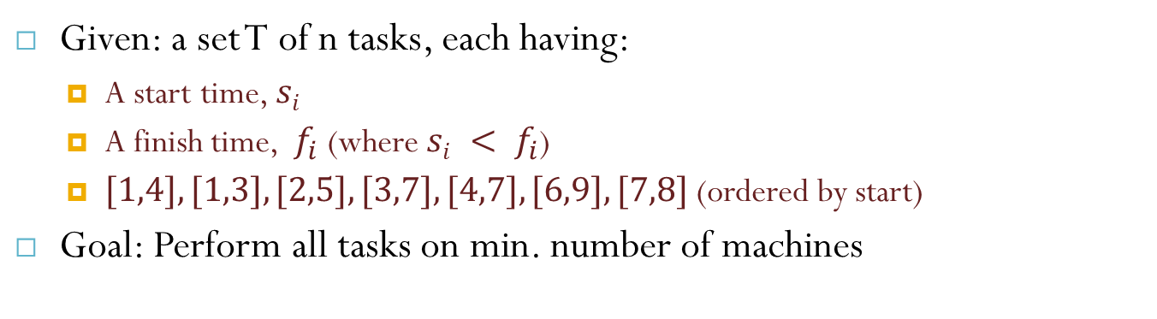
Example
Given: a set T of n tasks, each having:
A start time, $si$
A finish time, $f_{i}$ (where $si < f_{i}$)
$[1,4], [1,3], [2,5], [3,7], [4,7], [6,9], [7,8]$(ordered by start)
Goal: Perform all tasks on min. number of machines
Machine 3
Machine 2
Machine 1
1
2
3
4
5
6
7
8
9

Slide 15
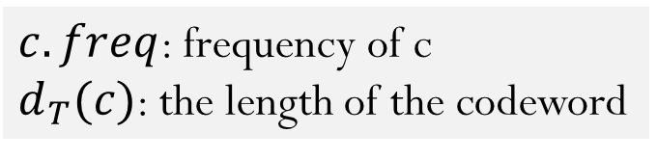
Huffman Code
Goal: Minimize number of bits required to encode a file.
$c.freq$: frequency of c
$d_{T}(c)$: the length of the codeword
source: 91.503 textbook Cormen, et al.

Slide 16
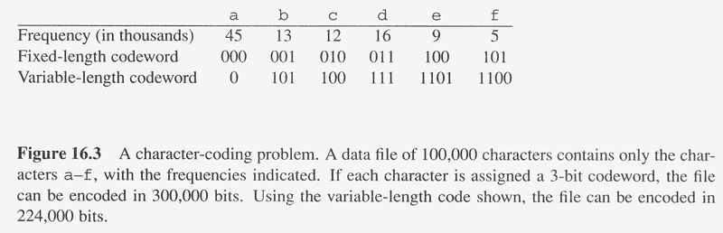
Huffman Codes
Compress data very effectively
Saving 20% to 90%
Prefix Code: No code is a prefix of any other.
Prefix codes are desirable (Simplifies decoding)
The codeword that begins an encoded file is unambiguous.
source: 91.503 textbook Cormen, et al.

Slide 17
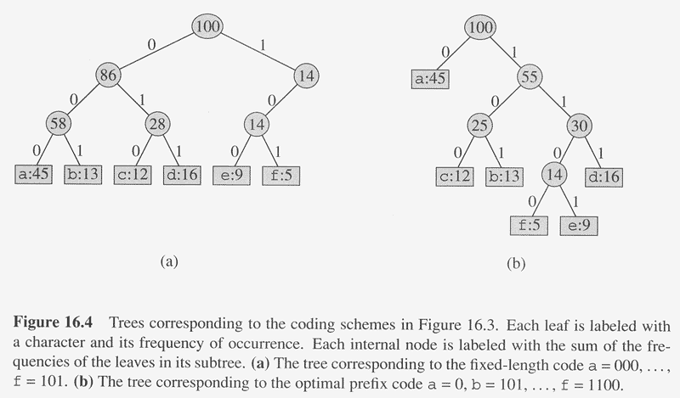
Code Tree Comparison
Fixed-length code: not optimal
Huffman prefix code: optimal
source: web site accompanying 91.503 textbook Cormen, et al.

Slide 18
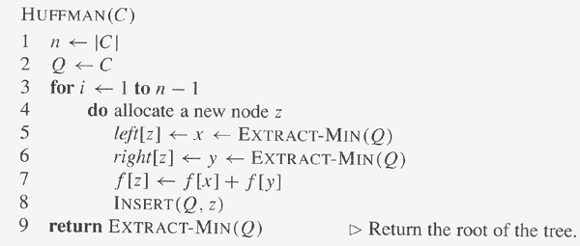

Huffman Code Greedy Algorithm
Running Time?
$$O(n logn)$$
source: 91.503 textbook Cormen, et al.

Slide 19
Example of Huffman Code Steps
f:5
e:9
c:12
b:13
d:16
a:45
c:12
b:13
14
d:16
a:45
f:5
e:9

Slide 20
Example of Huffman Code Steps
c:12
b:13
14
d:16
a:45
f:5
e:9
14
d:16
25
a:45
f:5
e:9
c:12
b:13

Slide 21
Example of Huffman Code Steps
14
d:16
25
a:45
f:5
e:9
c:12
b:13
25
30
a:45
14
d:16
c:12
b:13
f:5
e:9

Slide 22
Example of Huffman Code Steps
25
30
a:45
14
d:16
c:12
b:13
f:5
e:9
a:45
55
25
30
14
d:16
c:12
b:13
f:5
e:9

Slide 23
Example of Huffman Code Steps
100
a: 0
b: 101
c: 100
d: 111
e: 1101
f: 1100
0
1
a:45
55
1
0
25
30
1
0
1
0
14
d:16
c:12
b:13
0
1
f:5
e:9
source: 91.503 textbook Cormen, et al.

Slide 24
Reference
Algorithm Design: Foundations, Analysis, and Internet Examples. Michael T. Goodrich and Roberto Tamassia. John Wiley & Sons.
Introduction to Algorithms. Thomas H. Cormen, Charles E. Leiserson, Ronald L. Rivest, Clifford Stein.

Slide 25
Thank you!

